Slide 1
CS490
Tile Assembly Research
S
Christian Wendlandt

Slide 2
Motivation
Math & CS background
Unique opportunity
Easier to apply for Graduate School

Slide 3
What is Tile Assembly?
aTAM
abstract Tile Assembly Model
Tile set => Assembly
S
S
S
Notes:
Our research is based on aTAM
abstract Tile Assembly Model
aTAM defines a set of rules for combining tiles
We define a set of tiles and an Assembly that begins with the seed tile from our tile set

Slide 4
aTAM Rules
|Glues| <= |Faces|
Glue = (Strength, Label)
Tiles can’t be rotated, relocated, or overlap
Placed on a grid with matching glues
Iterative
Unlimited uses
Halting
Temperature = Minimum Strength Threshold
Tiles can only be placed if the sum of connecting glue strengths meets or exceeds a predefined temperature
Notes:
For 2D models, tiles have four faces and up to that many glues
Each glue has a strength and a label. In these examples:
Strength is the number of studs; Label is the stud color
Tiles cannot be rotated, moved once placed, or placed on each other
Tiles must be placed onto vacant cells adjacent to tiles with matching glues
At each step in the construction, a tile is picked from the tile set and added to the assembly
Each tile can be used from the tile set any number of times
This process continues until no more tiles can be placed
One additional requirement is Temperature
Tiles can only be placed if the sum of connecting glue strengths meets or exceeds a predefined temperature

Slide 5
S
S
S
Temperature = 2
Temperature = 1

Slide 6
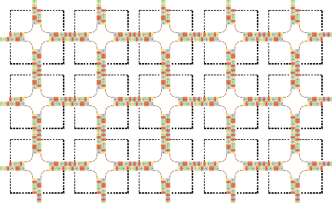
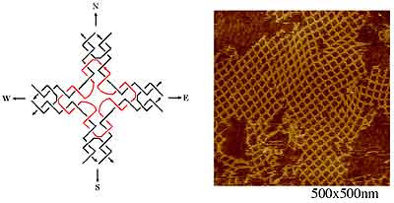
Applications
Self-Assembly is throughout nature
aTAM applies well to DNA
Minimizes cost

Slide 7
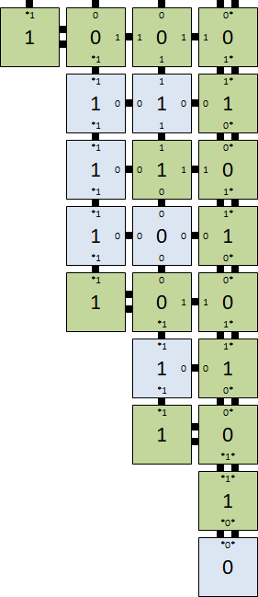
Counters
Large and precise structures
Cooperative Binding
Sum bit
0
1
0
1
Carry out
Carry in
1
Old bit
Notes:
Can built large precise structures with a small tile set
This structure relies heavily on Cooperative Binding

Slide 8
A Demonstration

Slide 9
Our Parameters
Temperature = 1
As a consequence, removes cooperative binding
“Just-Barely” 3D
Assembled in a linear fashion with minimal branching

Slide 10
Reading Bit-Bumps
00
10
01
11
Need another way to recall data
Data can be stored in the geometry
Reading Gadgets
Notes:
We need another way to remember data
Data can be stored in the geometry of the assembly
The solution is to hardcode substructures, called gadgets
Each gadget represents a different value
The value read corresponds to the gadget that can thread through the bumps

Slide 11
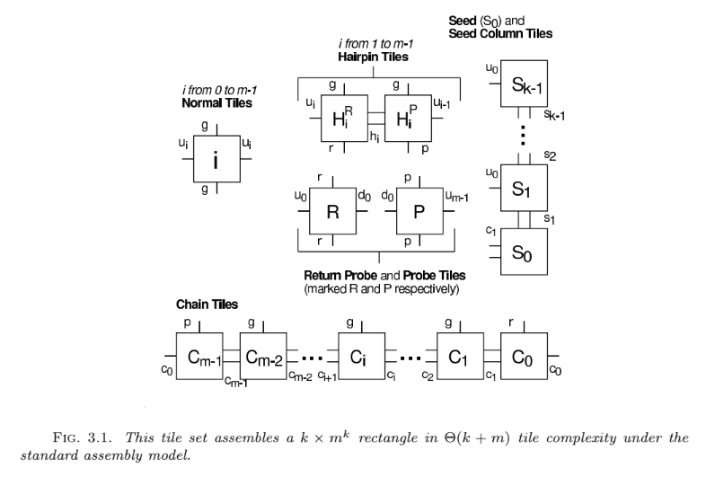
What We Did
N x k x 2 shape at temperature = 1
A very thin rectangle
Constructed a variable-base counter
Previous research
Notes:
My goal was to prove an upper bound on an N x k x 2 shape for temperature = 1
Which is a very thin rectangle of an arbitrarily long length
We designed it based on this 2D, temperature = 2, construction:

Slide 12
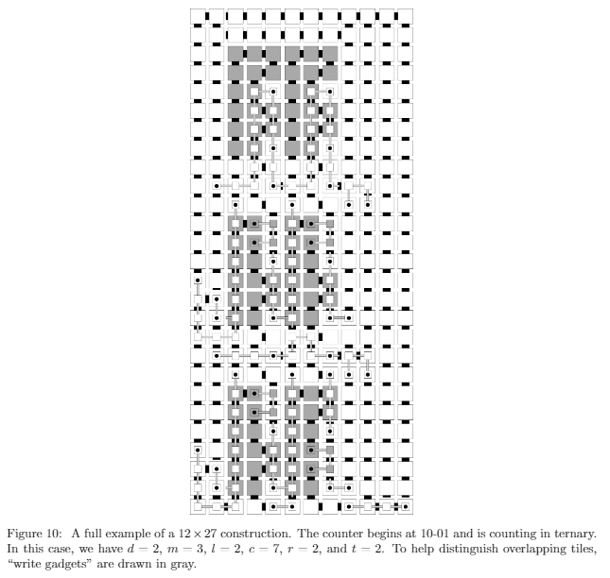
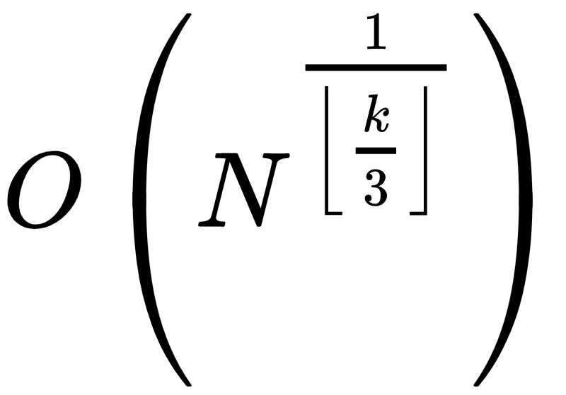
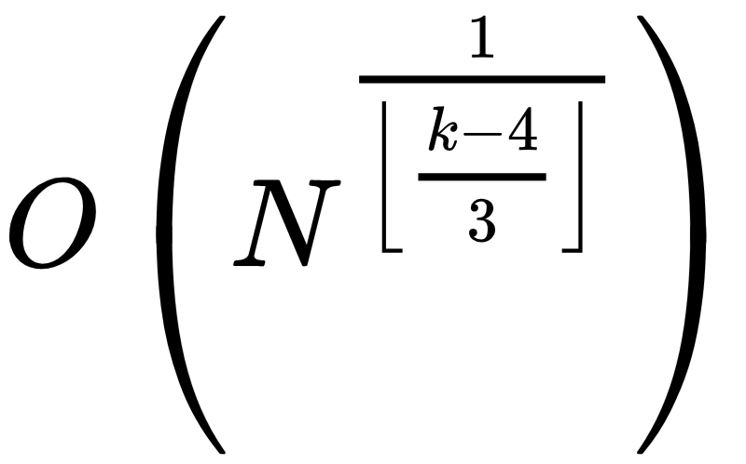
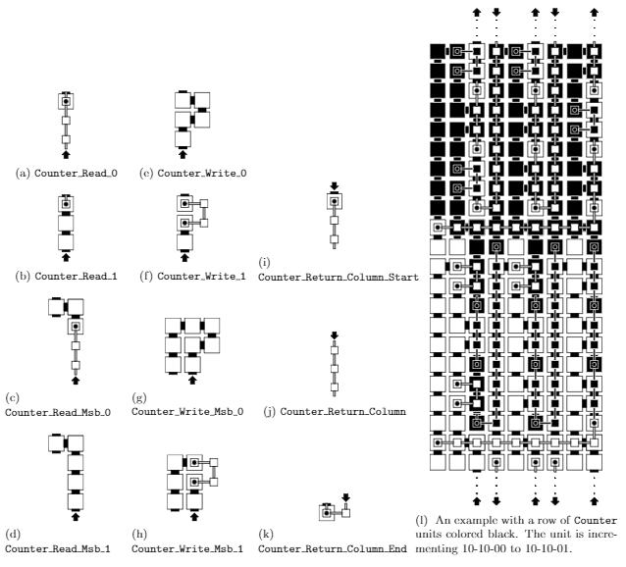
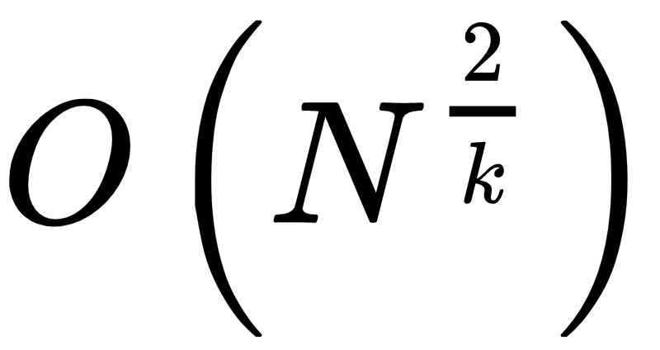
Proof by Construction
???

Slide 13
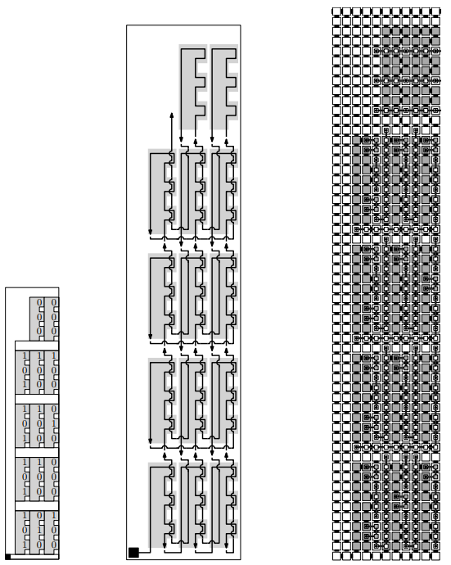

Overall Structure
(0)3^2+(0)3^1+(0)3^0=0
Starting value = 23
Counting base = 3
Number of Digits = 3
(2)3^2+(2)3^1+(2)3^0=26
(2)3^2+(2)3^1+(1)3^0=25
(2)3^2+(2)3^1+(0)3^0=24
(2)3^2+(1)3^1+(2)3^0=23
Bookkeeping Row

Slide 14
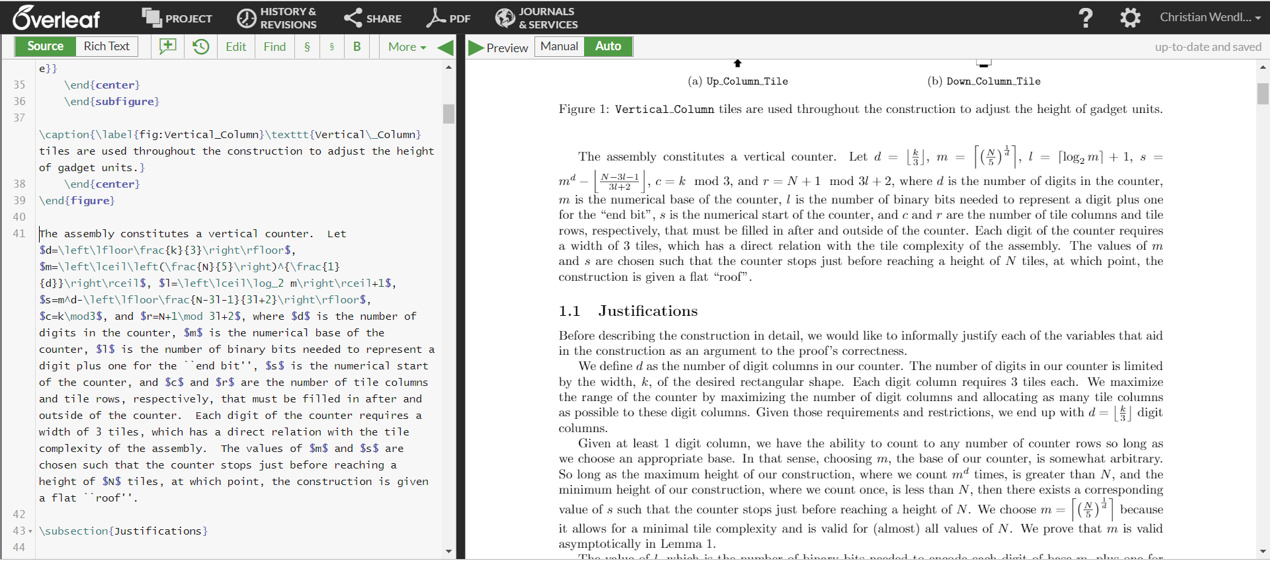
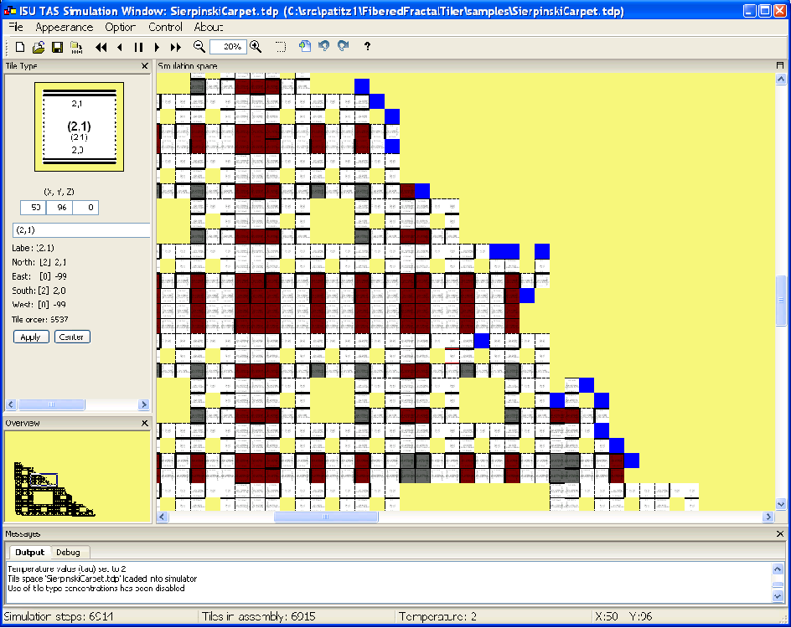
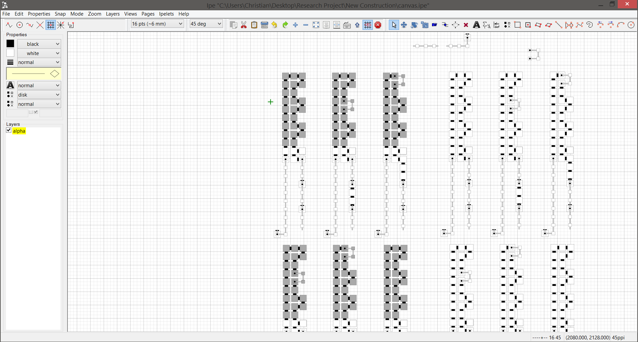
Software
LaTeX
IPE
TAS

Slide 15
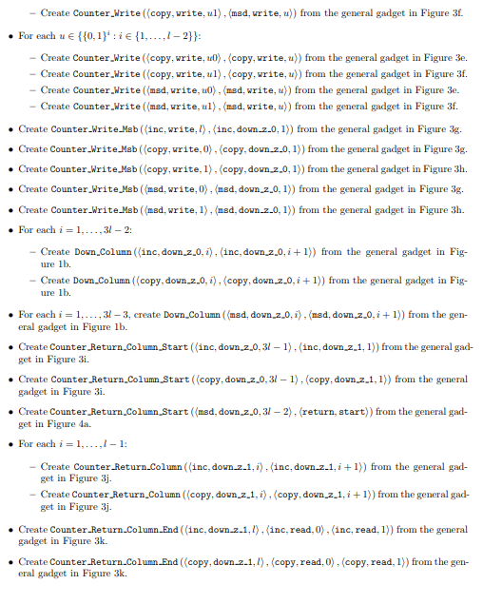
Pseudocode

Slide 16
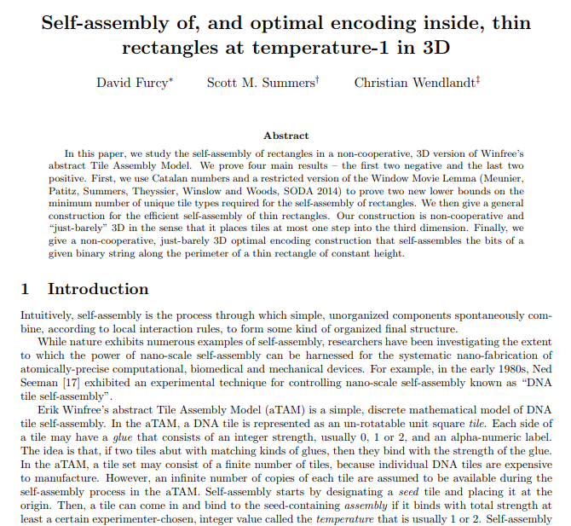
Challenges
Work at home
Independence
Detail
Rewrite
Becoming Famous

Slide 17
Questions?

